Slide 1
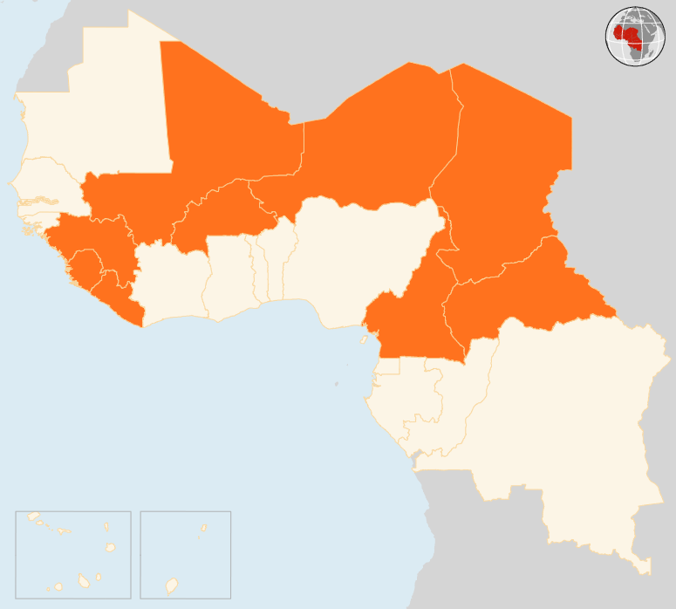
24 -30 Nov 2015
BURKINA FASO
BURKINA FASO
NEW PRESIDENT ELECTED AFTER PEACEFUL POLLS
Burkina Faso’s former prime minister Roch Marc Kaboré has been elected president following peaceful polls held on 29 November. The elections were the first since popular protests forced former president Blaise Compaoré to relinquish power in October 2014. The polls also ended a political transition that was marked by tensions and a short-lived coup.
CAMEROON
FIVE KILLED IN SUICIDE ATTACK
Two suicide bombers on 28 November attacked Dabanga village in northern Cameroon, killing five people. Boko Haram members, who have made numerous raids in the country’s Far North region since 2013, are suspected to be behind the attack.
CENTRAL AFRICAN REPUBLIC (CAR)
POPE URGES TOLERANCE, PEACE DURING VISIT
Pope Francis urged for tolerance and peace during a two-day visit to CAR on 29 - 30 November. In the capital Bangui, where violence flared up in September, the pontiff visited the displaced at Saint Sauveur site as well as the flashpoint PK 5 district where he met with the Muslim community.
CHAD
THREE DIE IN ARMED RAIDS
On 24 November, suspected Boko Haram members attacked Bolalé village in Baga-Sola area, killing two people. One other person was killed in a separate attack in Ngouboua locality on 20 November. Military presence has been reinforced following the state of emergency declared on 9 November and prolonged until March 2016.
MALI
PEACEKEEPERS KILLED IN ROCKET ATTACK
On 28 November, four rockets fired at MINUSMA base in Kidal killed two UN peacekeepers and a civilian. Twenty other people were injured, four of them seriously. UN Secretary-General Ban Ki-moon and the Security Council condemned the attack.
NIGER
EIGHTEEN KILLED IN VILLAGE ATTACK
Eighteen people were killed on 25 November by suspected Boko Haram gunmen during an attack on Wogom village near Bosso department in Diffa regions. Several villagers fled to seek safety elsewhere, but the exact number is still unknown.
EVD REGIONAL
NO NEW CASES IN LIBERIA
Liberia reported no new cases in the week ending on 29 November. Ebola resurfaced in the country on 19 November when a 15-year-old boy was diagnosed with the virus. The teenager died four days later, the first such fatality since July. The boy’s father and brother are being treated for Ebola. Around 150 contacts are being monitored. Guinea has recorded no cases for the past month. Sierra Leone was declared Ebola-free on 7 November.
.
NEW PRESIDENT ELECTED
MALI
NIGER
CHAD
2
PEACEKEEPERS KILLED
18
KILLED IN ATTACKS
3
KILLED IN ARMED RAID
CAR
POPE CALLS FOR TOLERANCE
EVD REGIONAL
CAMEROON
0
NEW CASES IN LIBERIA
5
KILLED IN SUICIDE ATTACK
Creation date: 01 December 2015 Map data sources: UNCS, DevInfo, OCHA. Feedback: ocharowca@un.org
The boundaries and names shown and the designations used on this map do not imply official endorsement or acceptance by the United Nations.

